Slide 2
Notes:
english<-c(90,80,60,70)
english
math<-c(50,60,100,20)
math
df_midterm<-data.frame(english,math)
df_midterm
class<-c(1,1,2,2)
class
df_midterm<-data.frame(english,math,class)
df_midterm
mean(df_midterm$english)
mean(df_midterm$math)

Slide 5
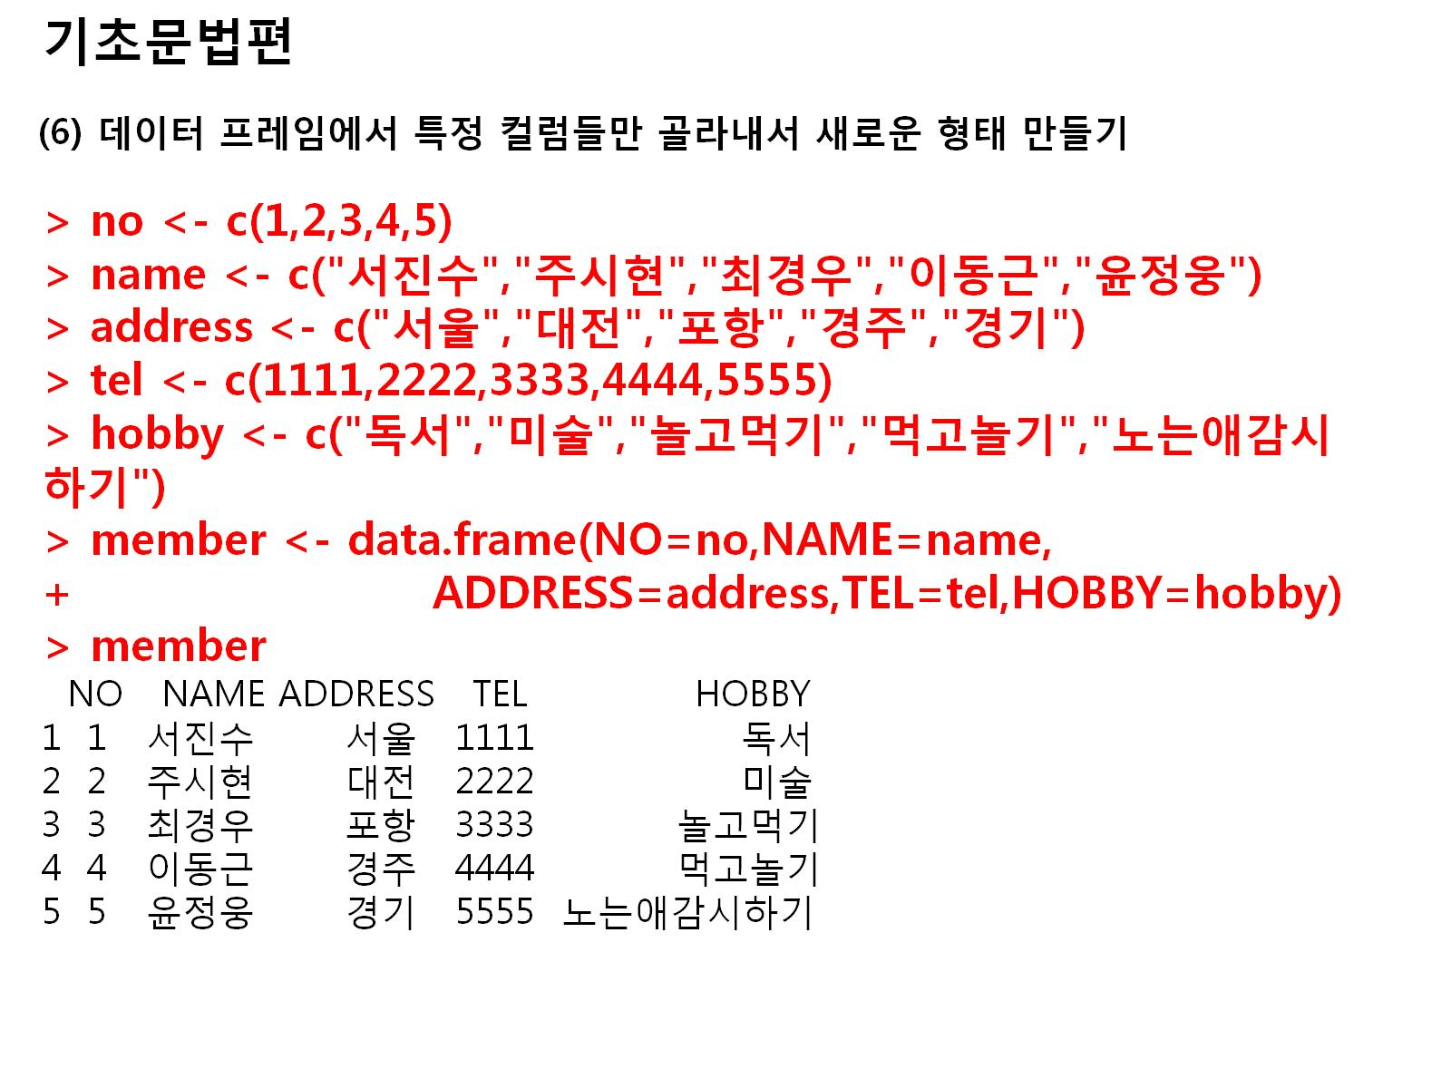
Notes:
no<-c(1,2,3,4,5)
name<-c("서진수","주시현","최경우","이동근","윤정웅")
address<-c("서울","대전","포항","경주","경기")
tel<-c(1111,2222,3333,4444,5555)
hobby<-c("독서","미술","놀고먹기","먹고놀기","노는애감시하기")
member<-data.frame(NO=no, NAME=name, ADDRESS=address, TEL=tel,HOBBY=hobby)
member

Slide 6
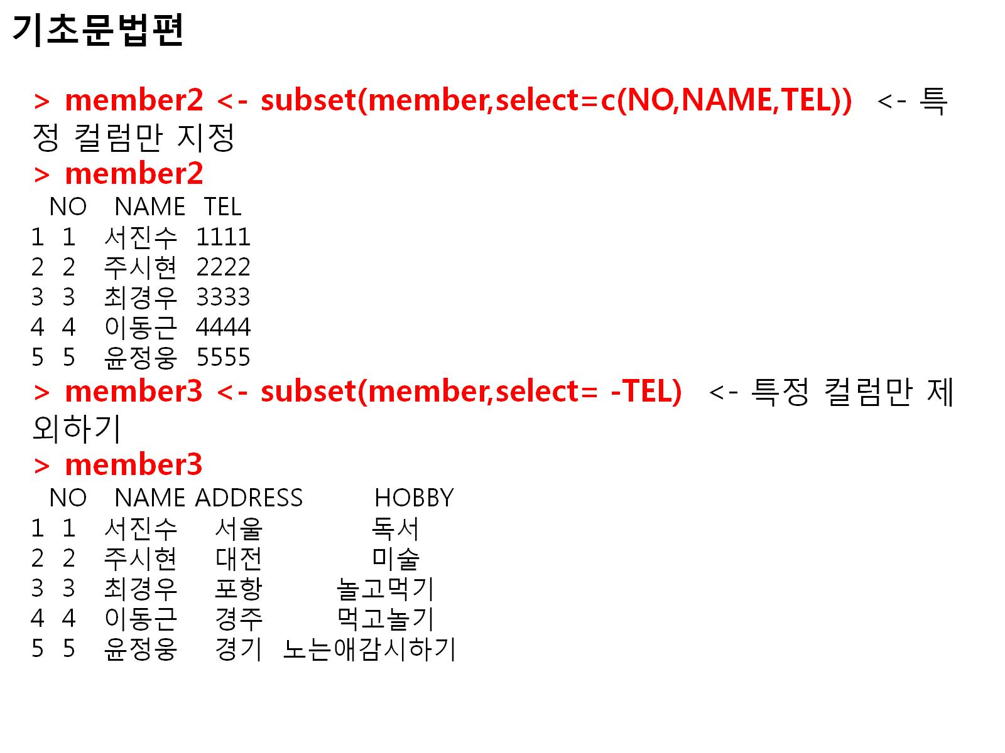
Notes:
no<-c(1,2,3,4,5)
name<-c("서진수","주시현","최경우","이동근","윤정웅")
address<-c("서울","대전","포항","경주","경기")
tel<-c(1111,2222,3333,4444,5555)
hobby<-c("독서","미술","놀고먹기","먹고놀기","노는애감시하기")
member<-data.frame(NO=no, NAME=name, ADDRESS=address, TEL=tel,HOBBY=hobby)
member
member2<-subset(member,select=c(NO,NAME,TEL))
member2
member3<-subset(member,select=-TEL)
member3

Slide 7
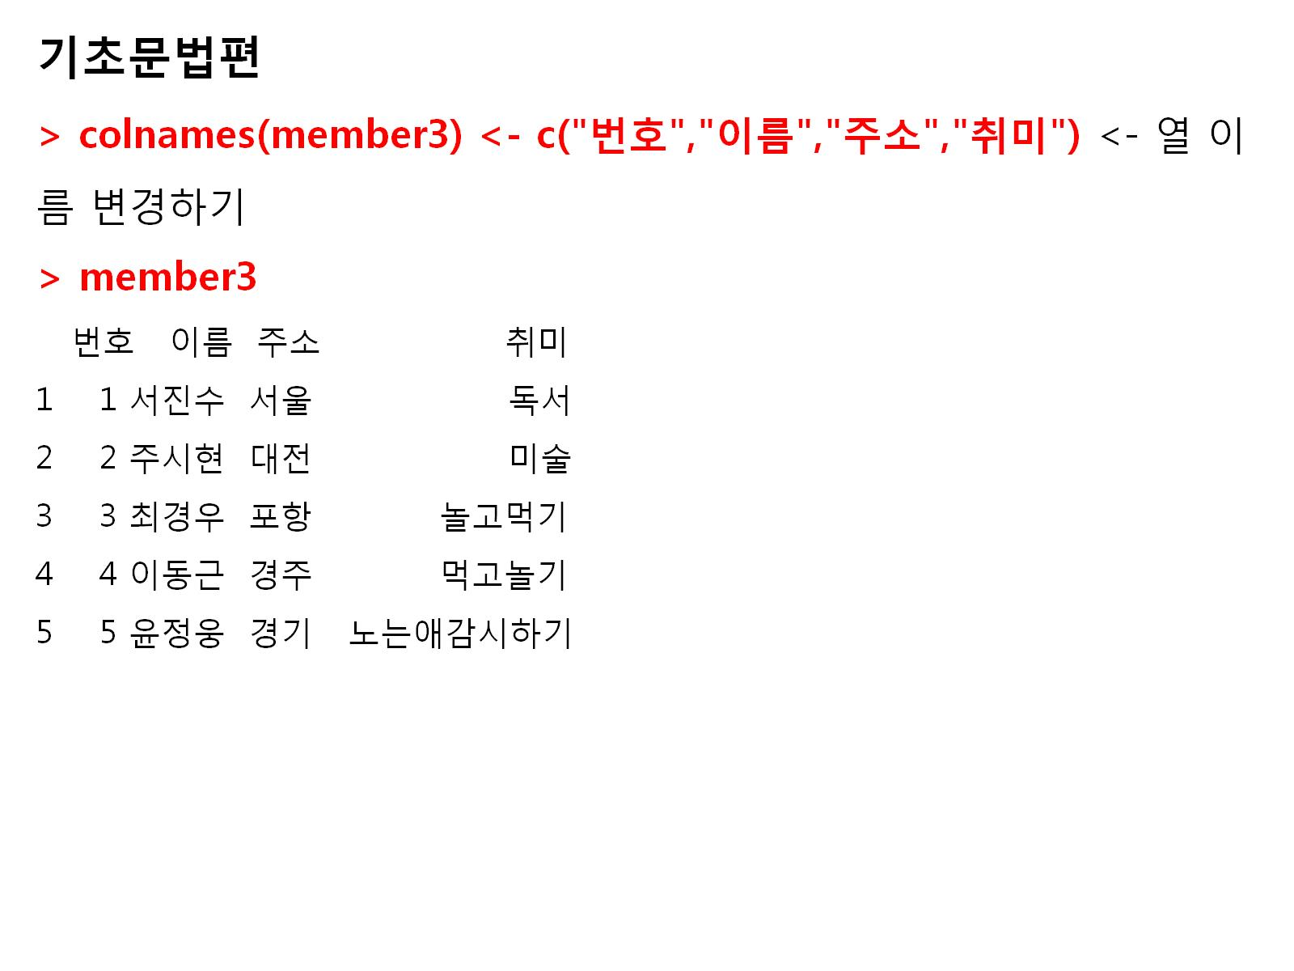
Notes:
colnames(member3)<-c("번호","이름","주소","취미")
member3

Slide 8
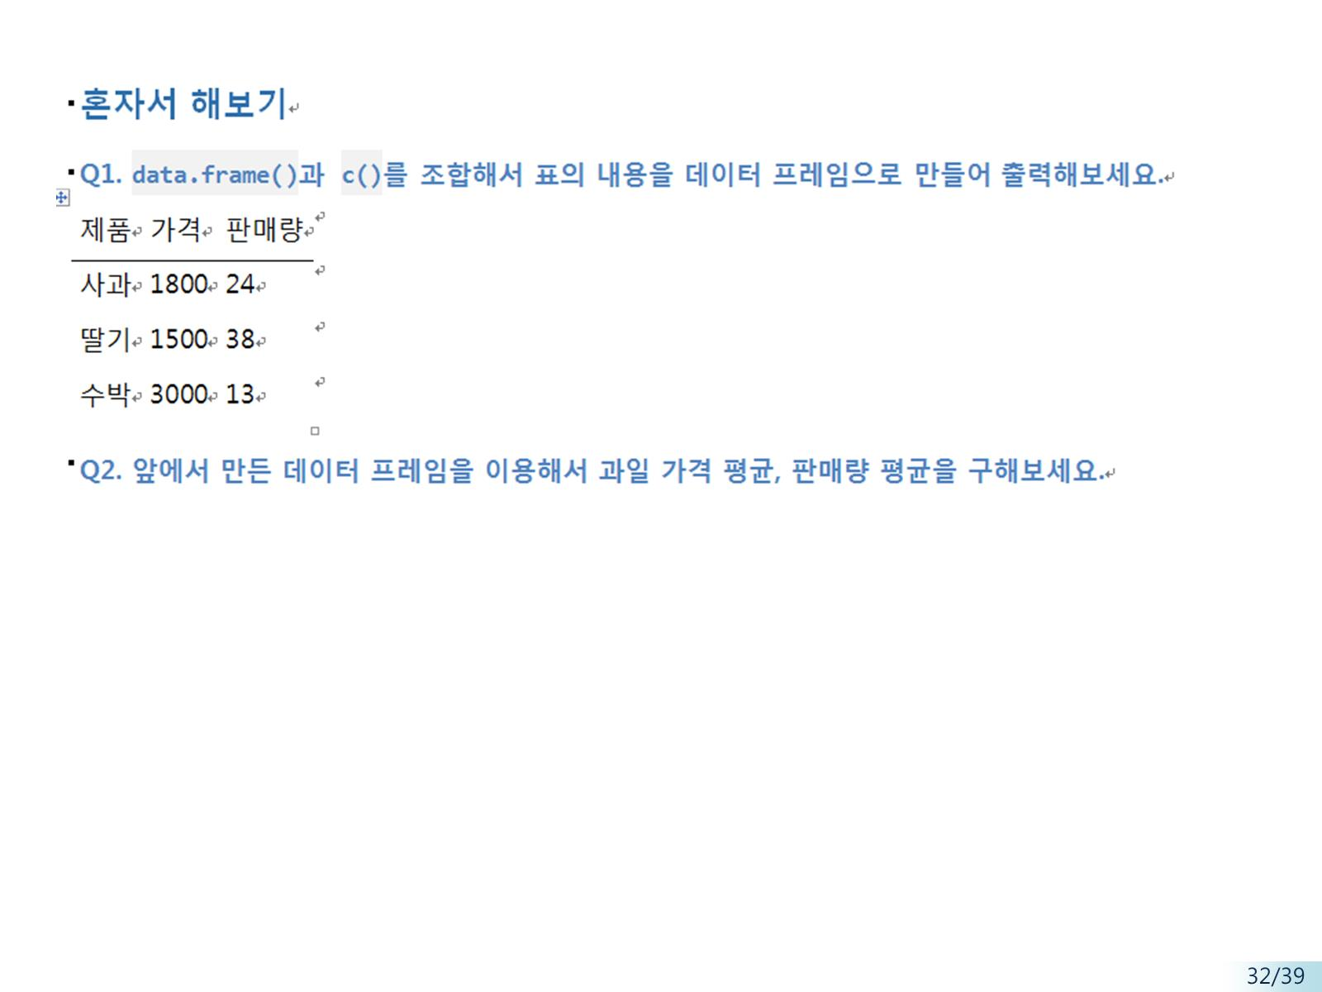
df1<-data.frame(name=c('사과','딸기','수박'), price=c(1800,1500,3000), qty=c(24,38,13))
df1<-data.frame(제품=name, 가격=price,판매량=qty)
df1
mean(df1$가격)
[1] "" [[22]] [1] "우리" "우리" "IMF" "위" "훌륭" "하게" "극복" "국민" "첫" [[23]] [1] "도입" "국민경선" "제" "성공" "국민" "사상" [7] "최대" "월드컵" "대회" "성공" "국민" "21" [13] "세" "첫" "대통령" "선거" "세계" "만큼" [19] "훌륭" "하게" "성공" "것" "국민" "힘" [25] "것" "국민" "의식" "수준" "결과" "누구" [31] "우리" "선진국민" "일류" "문화민족" "부인" "수" [37] "오늘" "순간" "우리" "세계" "당당" "한" [43] "선진국민" "일류" "문화민족" "확인" [[24]] [1] "" [[25]] [1] "정치" "행정" "경제" "언론" "법조" "등" "사회" "시스템" [9] "국민" "의식" "수준" "변" "화" [[26]] [1] "개혁" "것" "과제" "그것" "21" "세" "국가" "경쟁력" [9] "핵심" "저" "차" "기" [[27]] [1] "정부" "시대" "적" "소명" "저" "이번" "대통령" "선거" [9] "우리" "국민" "위대" "한" "저력" "가능성" "희망" "찬" [17] "미래" "실현" "국민" "대한" "민국" "건설" "국민" "여러분" [25] "보답" [[28]] [1] "" [[29]] [1] "국민" "여러분" "저" "힘" "국민" "여러분" "변함" "성원" [9] "당부" "드" [[30]] [1] "국민" "여러분" "가정" "건강" "행복" "기원" [[31]] [1] "국민" "여러분" "감사" > head(unlist(nouns),30) [1] "존경" "국민" "여러분" "사랑" "해외동포" "여러분" [7] "우리" "오늘" "참" "위대" "한" "승리" [13] "우리" "승리" "승자" "패자" "모두" "승리" [19] "국민" "모두" "승리" "대한" "민국" "승리" [25] "저" "영광" "국민" "여러분" "해외동포" "여러분" > cdata<-unlist(nouns) > nouns<-str_renouns_all(cdata,"[^[:alpha:]]","") Error in str_renouns_all(cdata, "[^[:alpha:]]", "") : could not find function "str_renouns_all" > nouns<-gsub(" ","",nouns) > txt<-readLines("박근혜대통령gsub.txt") Warning message: In readLines("박근혜대통령gsub.txt") : incomplete final line found on '諛뺢렐?쒕??듬졊gsub.txt' > txt [1] "올해" "비스" "대한민국" "추진" "우리" "정부" [7] "박근혜" "후보" "시대" "대한" "민국" "대통령" [13] "국민" "여러분" > cnt_txt<-length(txt) > cnt_txt [1] 14 > i<-1 > for(i in 1:cnt_txt){ + nouns<-gsub((txt[i]),"",nouns) + } > nouns [1] "c(\"존경\",\"\",\"\",\"사랑\",\"해외동포\",\"\",\"\",\"오늘\",\"참\",\"위대\",\"한\",\"승리\")" [2] "c(\"\",\"승리\",\"승자\",\"패자\",\"모두\",\"승리\",\"\",\"모두\",\"승리\",\"\",\"\",\"승리\",\"저\",\"영광\",\"\",\"\",\"해외동포\",\"\")" [3] "" [4] "c(\"존경\",\"\",\"\",\"\",\"\",\"희망\",\"찬\",\"역사\",\"시작\")" [5] "c(\"등\",\"분열\",\"\",\"7\",\"천\",\"겨레\",\"하나\",\"대통\",\"합의\",\"\",\"시작\",\"원칙\",\"신뢰\",\"정치\",\"시작\",\"평화\",\"번영\",\"한\",\"반\",\"\",\"정직\",\"하게\",\"일\",\"사람\",\"성공\",\"진정\",\"한\",\"사람\",\"사회\",\"투명\",\"공정\",\"한\",\"경제\",\"노사\",\"화합\",\"경제\",\"기업\",\"하기\",\"나라\",\"일자리\",\"경제\",\"취업\",\"실업\",\"어려움\",\"해결\",\"농어민\",\"들\",\"희망\",\"불우이웃\",\"장애인\",\"등\",\"소외계층\",\"따뜻\",\"한\",\"나라\",\"무엇\",\"실패\",\"사람\",\"재기\",\"꿈\",\"수\",\"나라\")" [6] "" [7] "c(\"끝\",\"선전\",\"한나라당\",\"이회\",\"창\",\"\",\"심심\",\"한\",\"위로\")" [8] "c(\"민주노동\",\"당\",\"권영길\",\"\",\"격려\",\"말씀\")" [9] "" [10] "c(\"존경\",\"\",\"\",\"저\",\"이번\",\"\",\"선거\",\"\",\"\",\"열망\",\"기대\",\"를\")" [11] "c(\"이번\",\"선거\",\"지역주의\",\"장벽\",\"데\",\"아쉬움\",\"가능\",\"희망\",\"발견\",\"포기\",\"노력\",\"통합\",\"내\")" [12] "" [13] "c(\"저\",\"\",\"\",\"\",\"긴급\",\"한\",\"과제\",\"험난\",\"한\",\"도전\")" [14] "c(\"저\",\"\",\"당선자\",\"북한\",\"핵문제\",\"한반도\",\"긴장\",\"해소\",\"데\",\"최선\",\"북한\",\"핵문제\",\"평화\",\"적\",\"해결\",\"하기\",\"\",\"주도\",\"적\",\"역할\",\"한.미간\",\"긴밀\",\"한\",\"공조\",\"협력\",\"SOFA\",\"개정\",\"등\",\"한.미간\",\"현안\",\"\",\"\",\"절실\",\"한\",\"기대\",\"저\",\"입장\",\"\",\"\",\"미국\",\"\",\"전달\",\"전통\",\"적\",\"한.미간\",\"우호\",\"동맹관계\",\"21\",\"세\",\"성숙\",\"발전\",\"한\",\"미관계\",\"차원\",\"양국\",\"\",\"진정\",\"한\",\"이해\",\"협력\",\"저\",\"양국\",\"인류\",\n\"보편적\",\"가치\",\"지향\",\"추구\",\"문화국가\",\"서로\",\"존엄\",\"인정\",\"발전\",\"것\")" [15] "" [16] "c(\"저\",\"한반도\",\"평화\",\"발전\",\"일\",\"본\",\"중국\",\"러시아\",\"EU\",\"등\",\"우방국\")" [17] "c(\"협력\",\"해\",\"정권\",\"인수작업\",\"차질\",\"시\",\"내\",\"직\",\"인수위원회\",\"구성\",\"\",\"출범\",\"전\",\"정권인수\",\"활동\",\"현정권\",\"임기\",\"말\",\"국정운영\",\"어던\",\"빈틈\",\"발생\",\"것\",\"유능\",\"한\",\"인재\",\"등용\",\"하기\",\"여론\",\"광범위\",\"하게\",\"수렴\",\"일거\",\"것\")" [18] "" [19] "c(\"존경\",\"\",\"\",\"이번\",\"\",\"것\",\"\",\"민족\",\"위대\",\"한\",\"저력\",\"한\",\"번\",\"과시\")" [20] "c(\"역사\",\"적\",\"계기\",\"\",\"\",\"사상\",\"최초\",\"돈\",\"선거\",\"깨끗\",\"한\",\"선거\",\"실천\",\"한\",\"\",\"\",\"\",\"사상\",\"최초\",\"수십\",\"유권자\",\"자발적\",\"성금\",\"자원봉사\",\"\",\"당선\",\"\",\"\",\"사상\",\"최초\",\"정책\",\"비전\",\"대결\",\"주도\",\"한\",\"\",\"선출\",\"\",\"\",\"사상\",\"최초\",\"통합\",\"정치혁명\",\"주창\",\"한\",\"\",\"선택\",\"열망\",\"정치\",\"혁명\",\"적\",\"변화\",\"시작\",\"것\",\"세계\",\"자랑\",\"만\",\"한\",\"일류\",\"정치가\",\"\",\"앞\")" [21] "" [22] "c(\"\",\"\",\"IMF\",\"위\",\"훌륭\",\"하게\",\"극복\",\"\",\"첫\")" [23] "c(\"도입\",\"경선\",\"제\",\"성공\",\"\",\"사상\",\"최대\",\"월드컵\",\"대회\",\"성공\",\"\",\"21\",\"세\",\"첫\",\"\",\"선거\",\"세계\",\"만큼\",\"훌륭\",\"하게\",\"성공\",\"것\",\"\",\"힘\",\"것\",\"\",\"의식\",\"수준\",\"결과\",\"누구\",\"\",\"선진\",\"일류\",\"문화민족\",\"부인\",\"수\",\"오늘\",\"순간\",\"\",\"세계\",\"당당\",\"한\",\"선진\",\"일류\",\"문화민족\",\"확인\")" [24] "" [25] "c(\"정치\",\"행정\",\"경제\",\"언론\",\"법조\",\"등\",\"사회\",\"시스템\",\"\",\"의식\",\"수준\",\"변\",\"화\")" [26] "c(\"개혁\",\"것\",\"과제\",\"그것\",\"21\",\"세\",\"국가\",\"경쟁력\",\"핵심\",\"저\",\"차\",\"기\")" [27] "c(\"\",\"\",\"적\",\"소명\",\"저\",\"이번\",\"\",\"선거\",\"\",\"\",\"위대\",\"한\",\"저력\",\"가능성\",\"희망\",\"찬\",\"미래\",\"실현\",\"\",\"\",\"\",\"건설\",\"\",\"\",\"보답\")" [28] "" [29] "c(\"\",\"\",\"저\",\"힘\",\"\",\"\",\"변함\",\"성원\",\"당부\",\"드\")" [30] "c(\"\",\"\",\"가정\",\"건강\",\"행복\",\"기원\")" [31] "c(\"\",\"\",\"감사\")" > nouns<-Filter(function(x){nchar(x)>=2},nouns) > write(unlist(nouns),"noh_2.txt") > rev<-read.table("noh_2.txt") > nrow(rev) [1] 24 > wordcount<-table(rev) > head(sort(wordcount,decreasing = T),30) rev ,"가치","지향","추구","문화국가","서로","존엄","인정","발전","것") 1 c("","","IMF","위","훌륭","하게","극복","","첫") 1 c("","","가정","건강","행복","기원") 1 c("","","감사") 1 c("","","저","힘","","","변함","성원","당부","드") 1 c("","","적","소명","저","이번","","선거","","","위대","한","저력","가능성","희망","찬","미래","실현","","","","건설","","","보답") 1 c("","승리","승자","패자","모두","승리","","모두","승리","","","승리","저","영광","","","해외동포","") 1 c("개혁","것","과제","그것","21","세","국가","경쟁력","핵심","저","차","기") 1 c("끝","선전","한나라당","이회","창","","심심","한","위로") 1 c("도입","경선","제","성공","","사상","최대","월드컵","대회","성공","","21","세","첫","","선거","세계","만큼","훌륭","하게","성공","것","","힘","것","","의식","수준","결과","누구","","선진","일류","문화민족","부인","수","오늘","순간","","세계","당당","한","선진","일류","문화민족","확인") 1 c("등","분열","","7","천","겨레","하나","대통","합의","","시작","원칙","신뢰","정치","시작","평화","번영","한","반","","정직","하게","일","사람","성공","진정","한","사람","사회","투명","공정","한","경제","노사","화합","경제","기업","하기","나라","일자리","경제","취업","실업","어려움","해결","농어민","들","희망","불우이웃","장애인","등","소외계층","따뜻","한","나라","무엇","실패","사람","재기","꿈","수","나라") 1 c("민주노동","당","권영길","","격려","말씀") 1 c("역사","적","계기","","","사상","최초","돈","선거","깨끗","한","선거","실천","한","","","","사상","최초","수십","유권자","자발적","성금","자원봉사","","당선","","","사상","최초","정책","비전","대결","주도","한","","선출","","","사상","최초","통합","정치혁명","주창","한","","선택","열망","정치","혁명","적","변화","시작","것","세계","자랑","만","한","일류","정치가","","앞") 1 c("이번","선거","지역주의","장벽","데","아쉬움","가능","희망","발견","포기","노력","통합","내") 1 c("저","","","","긴급","한","과제","험난","한","도전") 1 c("저","","당선자","북한","핵문제","한반도","긴장","해소","데","최선","북한","핵문제","평화","적","해결","하기","","주도","적","역할","한.미간","긴밀","한","공조","협력","SOFA","개정","등","한.미간","현안","","","절실","한","기대","저","입장","","","미국","","전달","전통","적","한.미간","우호","동맹관계","21","세","성숙","발전","한","미관계","차원","양국","","진정","한","이해","협력","저","양국","인류", 1 c("저","한반도","평화","발전","일","본","중국","러시아","EU","등","우방국") 1 c("정치","행정","경제","언론","법조","등","사회","시스템","","의식","수준","변","화") 1 c("존경","","","","","희망","찬","역사","시작") 1 c("존경","","","사랑","해외동포","","","오늘","참","위대","한","승리") 1 c("존경","","","이번","","것","","민족","위대","한","저력","한","번","과시") 1 c("존경","","","저","이번","","선거","","","열망","기대","를") 1 c("협력","해","정권","인수작업","차질","시","내","직","인수위원회","구성","","출범","전","정권인수","활동","현정권","임기","말","국정운영","어던","빈틈","발생","것","유능","한","인재","등용","하기","여론","광범위","하게","수렴","일거","것") 1 보편적 1 > library(RColorBrewer) > palete<-brewer.pal(9,"Set1") > wordcloud(names(wordcount),freq=wordcount,scale=c(5,0.5),rot.per = 0.25,min.freq=1,random.order = F,random.color=T,colors=palete) There were 23 warnings (use warnings() to see them) > legend(0.3,1, "故노무현 대통령님 연설문 분석",cex=0.8,fill=NA,border=NA,bg="white",text.col="red",text.font=2,box.col="red") > > > > > legend(0.3,1, "故노무현 대통령님 연설문 분석",cex=0.8,fill=NA,border=NA,bg="white",text.col="red",text.font=2,box.col="red") Error in strwidth(legend, units = "user", cex = cex, font = text.font) : plot.new has not been called yet > wordcloud(names(wordcount),freq=wordcount,scale=c(5,0.5),rot.per = 0.25,min.freq=1,random.order = F,random.color=T,colors=palete) There were 23 warnings (use warnings() to see them) > legend(0.3,1, "故노무현 대통령님 연설문 분석",cex=0.8,fill=NA,border=NA,bg="white",text.col="red",text.font=2,box.col="red") > setwd("c:\\easy_r") > install.packages("KoNLP") Error in install.packages : Updating loaded packages > install.packages("wordcloud") Error in install.packages : Updating loaded packages > install.packages("stringr") Error in install.packages : Updating loaded packages > library(KoNLP) > library(wordcloud) > library(stringr) > useSejongDic() Backup was just finished! Downloading package from url: https://github.com/haven-jeon/NIADic/releases/download/0.0.1/NIADic_0.0.1.tar.gz Restarting R session... > install.packages("KoNLP") trying URL 'https://cran.rstudio.com/bin/windows/contrib/3.4/KoNLP_0.80.1.zip' Content type 'application/zip' length 5867390 bytes (5.6 MB) downloaded 5.6 MB package ‘KoNLP’ successfully unpacked and MD5 sums checked The downloaded binary packages are in C:\Users\student\AppData\Local\Temp\Rtmp6BU3Q0\downloaded_packages > nrow(rev) [1] 24 > wordcount<-table(rev) > head(sort(wordcount,decreasing = T),30) rev ,"가치","지향","추구","문화국가","서로","존엄","인정","발전","것") 1 c("","","IMF","위","훌륭","하게","극복","","첫") 1 c("","","가정","건강","행복","기원") 1 c("","","감사") 1 c("","","저","힘","","","변함","성원","당부","드") 1 c("","","적","소명","저","이번","","선거","","","위대","한","저력","가능성","희망","찬","미래","실현","","","","건설","","","보답") 1 c("","승리","승자","패자","모두","승리","","모두","승리","","","승리","저","영광","","","해외동포","") 1 c("개혁","것","과제","그것","21","세","국가","경쟁력","핵심","저","차","기") 1 c("끝","선전","한나라당","이회","창","","심심","한","위로") 1 c("도입","경선","제","성공","","사상","최대","월드컵","대회","성공","","21","세","첫","","선거","세계","만큼","훌륭","하게","성공","것","","힘","것","","의식","수준","결과","누구","","선진","일류","문화민족","부인","수","오늘","순간","","세계","당당","한","선진","일류","문화민족","확인") 1 c("등","분열","","7","천","겨레","하나","대통","합의","","시작","원칙","신뢰","정치","시작","평화","번영","한","반","","정직","하게","일","사람","성공","진정","한","사람","사회","투명","공정","한","경제","노사","화합","경제","기업","하기","나라","일자리","경제","취업","실업","어려움","해결","농어민","들","희망","불우이웃","장애인","등","소외계층","따뜻","한","나라","무엇","실패","사람","재기","꿈","수","나라") 1 c("민주노동","당","권영길","","격려","말씀") 1 c("역사","적","계기","","","사상","최초","돈","선거","깨끗","한","선거","실천","한","","","","사상","최초","수십","유권자","자발적","성금","자원봉사","","당선","","","사상","최초","정책","비전","대결","주도","한","","선출","","","사상","최초","통합","정치혁명","주창","한","","선택","열망","정치","혁명","적","변화","시작","것","세계","자랑","만","한","일류","정치가","","앞") 1 c("이번","선거","지역주의","장벽","데","아쉬움","가능","희망","발견","포기","노력","통합","내") 1 c("저","","","","긴급","한","과제","험난","한","도전") 1 c("저","","당선자","북한","핵문제","한반도","긴장","해소","데","최선","북한","핵문제","평화","적","해결","하기","","주도","적","역할","한.미간","긴밀","한","공조","협력","SOFA","개정","등","한.미간","현안","","","절실","한","기대","저","입장","","","미국","","전달","전통","적","한.미간","우호","동맹관계","21","세","성숙","발전","한","미관계","차원","양국","","진정","한","이해","협력","저","양국","인류", 1 c("저","한반도","평화","발전","일","본","중국","러시아","EU","등","우방국") 1 c("정치","행정","경제","언론","법조","등","사회","시스템","","의식","수준","변","화") 1 c("존경","","","","","희망","찬","역사","시작") 1 c("존경","","","사랑","해외동포","","","오늘","참","위대","한","승리") 1 c("존경","","","이번","","것","","민족","위대","한","저력","한","번","과시") 1 c("존경","","","저","이번","","선거","","","열망","기대","를") 1 c("협력","해","정권","인수작업","차질","시","내","직","인수위원회","구성","","출범","전","정권인수","활동","현정권","임기","말","국정운영","어던","빈틈","발생","것","유능","한","인재","등용","하기","여론","광범위","하게","수렴","일거","것") 1 보편적 1 > setwd("c:\\easy_r") > install.packages("KoNLP") trying URL 'https://cran.rstudio.com/bin/windows/contrib/3.4/KoNLP_0.80.1.zip' Content type 'application/zip' length 5867390 bytes (5.6 MB) downloaded 5.6 MB package ‘KoNLP’ successfully unpacked and MD5 sums checked The downloaded binary packages are in C:\Users\student\AppData\Local\Temp\Rtmp6BU3Q0\downloaded_packages > install.packages("wordcloud") trying URL 'https://cran.rstudio.com/bin/windows/contrib/3.4/wordcloud_2.5.zip' Content type 'application/zip' length 566427 bytes (553 KB) downloaded 553 KB package ‘wordcloud’ successfully unpacked and MD5 sums checked The downloaded binary packages are in C:\Users\student\AppData\Local\Temp\Rtmp6BU3Q0\downloaded_packages > library(KoNLP) Checking user defined dictionary! > library(wordcloud) 필요한 패키지를 로딩중입니다: RColorBrewer > txt<-readLines("noh.txt") > nouns<-sapply(txt,extractNoun,USE.NAMES = F) > head(unlist(nouns),30) [1] "존경" "국민" "여러분" "사랑" "해외동포" "여러분" [7] "우리" "오늘" "참" "위대" "한" "승리" [13] "우리" "승리" "승자" "패자" "모두" "승리" [19] "국민" "모두" "승리" "대한" "민국" "승리" [25] "저" "영광" "국민" "여러분" "해외동포" "여러분" > nouns<-Filter(function(x){nchar(x)>=2},nouns) > write(unlist(nouns),"noh_2.txt") > rev<-read.table("noh_2.txt") > nrow(rev) [1] 440 > wordcount<-table(rev) > head(sort(wordcount,decreasing = T),30) rev 국민 한 우리 여러분 저 대통령 것 적 사상 선거 24 22 17 12 10 9 8 6 5 5 승리 대한 등 민국 성공 시대 시작 정부 존경 최초 5 4 4 4 4 4 4 4 4 4 하게 21 경제 나라 발전 사람 세 세계 위대 이번 4 3 3 3 3 3 3 3 3 3 > library(RColorBrewer) > palete<-brewer.pal(9,"Set1") > wordcloud(names(wordcount),freq=wordcount,scale=c(5,0.5),rot.per = 0.25,min.freq=1,random.order = F,random.color=T,colors=palete) There were 36 warnings (use warnings() to see them) > legend(0.3,1, "故노무현 대통령님 연설문 분석",cex=0.8,fill=NA,border=NA,bg="white",text.col="red",text.font=2,box.col="red") > setwd("c:\\easy_r") There were 12 warnings (use warnings() to see them) > install.packages("KoNLP") Error in install.packages : Updating loaded packages > install.packages("wordcloud") Error in install.packages : Updating loaded packages > library(KoNLP) > library(wordcloud) > txt<-readLines("job_20.txt") > nouns<-sapply(txt,extractNoun,USE.NAMES = F) Restarting R session... Error: Unable to establish connection with R session > setwd("c:\\easy_r") > install.packages("KoNLP") trying URL 'https://cran.rstudio.com/bin/windows/contrib/3.4/KoNLP_0.80.1.zip' Content type 'application/zip' length 5867390 bytes (5.6 MB) downloaded 5.6 MB package ‘KoNLP’ successfully unpacked and MD5 sums checked The downloaded binary packages are in C:\Users\student\AppData\Local\Temp\RtmpSGbD4c\downloaded_packages > install.packages("wordcloud") trying URL 'https://cran.rstudio.com/bin/windows/contrib/3.4/wordcloud_2.5.zip' Content type 'application/zip' length 566427 bytes (553 KB) downloaded 553 KB package ‘wordcloud’ successfully unpacked and MD5 sums checked The downloaded binary packages are in C:\Users\student\AppData\Local\Temp\RtmpSGbD4c\downloaded_packages > library(KoNLP) Checking user defined dictionary! > library(wordcloud) 필요한 패키지를 로딩중입니다: RColorBrewer > txt<-readLines("job_20.txt") > nouns<-sapply(txt,extractNoun,USE.NAMES = F) > head(unlist(nouns),30) [1] "스" "쿨" "스" "쿨" "지" "스" "쿨" [8] "수" "료" "거" "금" "류" "절" "차" [15] "지" "혜" "택" "당구" "장" "데" "당구" [22] "장" "나" "어떨" "사이트" "곳" "월수" "입" [29] "월수" "입" > nouns<-Filter(function(x){nchar(x)>=2},nouns) > write(unlist(nouns),"job_20_2.txt") > rev<-read.table("job_20_2.txt") > nrow(rev) [1] 4399 > wordcount<-table(rev) > head(sort(wordcount,decreasing = T),30) rev 수 창업 점 기 인 소상 것 155 112 67 66 58 54 47 공 지 추천 페 답변 대 업 47 45 45 43 42 41 41 저 조회 1 30 금 장 학 41 40 37 37 37 36 35 즈 사 2 프랜차이 경제 문 부 31 30 26 25 24 24 24 음식 중 24 24 > library(RColorBrewer) > palete<-brewer.pal(9,"Set1") > wordcloud(names(wordcount),freq=wordcount,scale=c(5,0.5),rot.per = 0.25,min.freq=1,random.order = F,random.color=T,colors=palete) There were 50 or more warnings (use warnings() to see the first 50) > legend(0.3,1, "20대 창업 관련 분석",cex=0.8,fill=NA,border=NA,bg="white",text.col="red",text.font=2,box.col="red") > wordcloud(names(wordcount),freq=wordcount,scale=c(5,0.5),rot.per = 0.25,min.freq=1,random.order = F,random.color=T,colors=palete) There were 50 or more warnings (use warnings() to see the first 50) > legend(0.3,1, "20대 창업 관련 분석",cex=0.8,fill=NA,border=NA,bg="white",text.col="red",text.font=2,box.col="red") > setwd("c:\\easy_r") > install.packages("KoNLP") Error in install.packages : Updating loaded packages > install.packages("wordcloud") Error in install.packages : Updating loaded packages > library(KoNLP) > library(wordcloud) > txt<-readLines("job_30.txt") > nouns<-sapply(txt,extractNoun,USE.NAMES = F) Restarting R session... > install.packages("KoNLP") trying URL 'https://cran.rstudio.com/bin/windows/contrib/3.4/KoNLP_0.80.1.zip' Content type 'application/zip' length 5867390 bytes (5.6 MB) downloaded 5.6 MB package ‘KoNLP’ successfully unpacked and MD5 sums checked The downloaded binary packages are in C:\Users\student\AppData\Local\Temp\RtmpKsSBgo\downloaded_packages > setwd("c:\\easy_r") > install.packages("KoNLP") trying URL 'https://cran.rstudio.com/bin/windows/contrib/3.4/KoNLP_0.80.1.zip' Content type 'application/zip' length 5867390 bytes (5.6 MB) downloaded 5.6 MB package ‘KoNLP’ successfully unpacked and MD5 sums checked The downloaded binary packages are in C:\Users\student\AppData\Local\Temp\RtmpKsSBgo\downloaded_packages > install.packages("wordcloud") trying URL 'https://cran.rstudio.com/bin/windows/contrib/3.4/wordcloud_2.5.zip' Content type 'application/zip' length 566427 bytes (553 KB) downloaded 553 KB package ‘wordcloud’ successfully unpacked and MD5 sums checked The downloaded binary packages are in C:\Users\student\AppData\Local\Temp\RtmpKsSBgo\downloaded_packages > library(KoNLP) Checking user defined dictionary! > library(wordcloud) 필요한 패키지를 로딩중입니다: RColorBrewer > txt<-readLines("job_30.txt") > nouns<-sapply(txt,extractNoun,USE.NAMES = F) > head(unlist(nouns),30) [1] " " "30" "대" [4] "창업" "아이템" "추천" [7] "2015." "02." "17" [10] "30" "대" "창업" [13] "아이템" "추천" "30" [16] "대" "창업" "하기때문에" [19] "성공해야만합니다" "안정" "적" [22] "수익" "날" "수" [25] "업종" "시작" "30" [28] "대" "창업" "바" > nouns<-Filter(function(x){nchar(x)>=2},nouns) > write(unlist(nouns),"job_30_2.txt") > rev<-read.table("job_30_2.txt") > nrow(rev) [1] 5925 > wordcount<-table(rev) > head(sort(wordcount,decreasing = T),30) rev 수 창업 대 답변 추천 30 416 376 154 151 150 138 조회 1 경제 0 2014. 저 131 116 92 78 77 74 2 2015. 한 것 생각 아이템 66 54 52 49 48 47 4 3 5 20 프랜차이즈 준비 44 43 41 40 39 34 적 04. 7 중 안녕 직장 33 31 30 29 26 26 > library(RColorBrewer) > palete<-brewer.pal(9,"Set1") > wordcloud(names(wordcount),freq=wordcount,scale=c(5,0.5),rot.per = 0.25,min.freq=1,random.order = F,random.color=T,colors=palete) There were 50 or more warnings (use warnings() to see the first 50) > legend(0.3,1, "30대 창업 관련 분석",cex=0.8,fill=NA,border=NA,bg="white",text.col="red",text.font=5,box.col="red") > setwd("c:\\easy_r") > install.packages("KoNLP") Error in install.packages : Updating loaded packages > install.packages("wordcloud") Error in install.packages : Updating loaded packages > library(KoNLP) > library(wordcloud) > txt<-readLines("job_30.txt") > nouns<-sapply(txt,extractNoun,USE.NAMES = F) Restarting R session... Error: Unable to establish connection with R session > setwd("c:\\easy_r") > install.packages("KoNLP") trying URL 'https://cran.rstudio.com/bin/windows/contrib/3.4/KoNLP_0.80.1.zip' Content type 'application/zip' length 5867390 bytes (5.6 MB) downloaded 5.6 MB package ‘KoNLP’ successfully unpacked and MD5 sums checked The downloaded binary packages are in C:\Users\student\AppData\Local\Temp\RtmpEjzMtK\downloaded_packages > install.packages("wordcloud") trying URL 'https://cran.rstudio.com/bin/windows/contrib/3.4/wordcloud_2.5.zip' Content type 'application/zip' length 566427 bytes (553 KB) downloaded 553 KB package ‘wordcloud’ successfully unpacked and MD5 sums checked The downloaded binary packages are in C:\Users\student\AppData\Local\Temp\RtmpEjzMtK\downloaded_packages > library(KoNLP) Checking user defined dictionary! > library(wordcloud) 필요한 패키지를 로딩중입니다: RColorBrewer > txt<-readLines("job_30.txt") > nouns<-sapply(txt,extractNoun,USE.NAMES = F) > head(unlist(nouns),30) [1] " " "30" "대" [4] "창업" "아이템" "추천" [7] "2015." "02." "17" [10] "30" "대" "창업" [13] "아이템" "추천" "30" [16] "대" "창업" "하기때문에" [19] "성공해야만합니다" "안정" "적" [22] "수익" "날" "수" [25] "업종" "시작" "30" [28] "대" "창업" "바" > nouns<-Filter(function(x){nchar(x)>=2},nouns) > write(unlist(nouns),"job_30_2.txt") > rev<-read.table("job_30_2.txt") > nrow(rev) [1] 5925 > wordcount<-table(rev) > head(sort(wordcount,decreasing = T),30) rev 수 창업 대 답변 추천 30 416 376 154 151 150 138 조회 1 경제 0 2014. 저 131 116 92 78 77 74 2 2015. 한 것 생각 아이템 66 54 52 49 48 47 4 3 5 20 프랜차이즈 준비 44 43 41 40 39 34 적 04. 7 중 안녕 직장 33 31 30 29 26 26 > library(RColorBrewer) > palete<-brewer.pal(9,"Set1") > wordcloud(names(wordcount),freq=wordcount,scale=c(5,0.5),rot.per = 0.25,min.freq=1,random.order = F,random.color=T,colors=palete) There were 50 or more warnings (use warnings() to see the first 50) > legend(0.3,1, "30대 창업 관련 분석",cex=0.8,fill=NA,border=NA,bg="white",text.col="red",text.font=65,box.col="red") > setwd("c:\\easy_r") > install.packages("KoNLP") Error in install.packages : Updating loaded packages > install.packages("wordcloud") Error in install.packages : Updating loaded packages > library(KoNLP) > library(wordcloud) > txt<-readLines("job_30.txt") > nouns<-sapply(txt,extractNoun,USE.NAMES = F) > head(unlist(nouns),30) [1] " " "30" "대" [4] "창업" "아이템" "추천" [7] "2015." "02." "17" [10] "30" "대" "창업" [13] "아이템" "추천" "30" [16] "대" "창업" "하기때문에" [19] "성공해야만합니다" "안정" "적" [22] "수익" "날" "수" [25] "업종" "시작" "30" [28] "대" "창업" "바" > nouns<-Filter(function(x){nchar(x)>=2},nouns) > write(unlist(nouns),"job_30_2.txt") > rev<-read.table("job_30_2.txt") > nrow(rev) [1] 5925 > wordcount<-table(rev) > head(sort(wordcount,decreasing = T),30) rev 수 창업 대 답변 추천 30 416 376 154 151 150 138 조회 1 경제 0 2014. 저 131 116 92 78 77 74 2 2015. 한 것 생각 아이템 66 54 52 49 48 47 4 3 5 20 프랜차이즈 준비 44 43 41 40 39 34 적 04. 7 중 안녕 직장 33 31 30 29 26 26 > library(RColorBrewer) > palete<-brewer.pal(9,"Set1") > wordcloud(names(wordcount),freq=wordcount,scale=c(5,0.5),rot.per = 0.25,min.freq=1,random.order = F,random.color=T,colors=palete) Restarting R session... > install.packages("KoNLP") trying URL 'https://cran.rstudio.com/bin/windows/contrib/3.4/KoNLP_0.80.1.zip' Content type 'application/zip' length 5867390 bytes (5.6 MB) downloaded 5.6 MB package ‘KoNLP’ successfully unpacked and MD5 sums checked The downloaded binary packages are in C:\Users\student\AppData\Local\Temp\RtmpA5b1iE\downloaded_packages > setwd("c:\\easy_r") > install.packages("KoNLP") trying URL 'https://cran.rstudio.com/bin/windows/contrib/3.4/KoNLP_0.80.1.zip' Content type 'application/zip' length 5867390 bytes (5.6 MB) downloaded 5.6 MB package ‘KoNLP’ successfully unpacked and MD5 sums checked The downloaded binary packages are in C:\Users\student\AppData\Local\Temp\RtmpA5b1iE\downloaded_packages > install.packages("wordcloud") trying URL 'https://cran.rstudio.com/bin/windows/contrib/3.4/wordcloud_2.5.zip' Content type 'application/zip' length 566427 bytes (553 KB) downloaded 553 KB package ‘wordcloud’ successfully unpacked and MD5 sums checked The downloaded binary packages are in C:\Users\student\AppData\Local\Temp\RtmpA5b1iE\downloaded_packages > library(KoNLP) Checking user defined dictionary! > library(wordcloud) 필요한 패키지를 로딩중입니다: RColorBrewer > txt<-readLines("job_30.txt") > nouns<-sapply(txt,extractNoun,USE.NAMES = F) > head(unlist(nouns),30) [1] " " "30" "대" [4] "창업" "아이템" "추천" [7] "2015." "02." "17" [10] "30" "대" "창업" [13] "아이템" "추천" "30" [16] "대" "창업" "하기때문에" [19] "성공해야만합니다" "안정" "적" [22] "수익" "날" "수" [25] "업종" "시작" "30" [28] "대" "창업" "바" > nouns<-Filter(function(x){nchar(x)>=2},nouns) > write(unlist(nouns),"job_30_2.txt") > rev<-read.table("job_30_2.txt") > nrow(rev) [1] 5925 > wordcount<-table(rev) > head(sort(wordcount,decreasing = T),30) rev 수 창업 대 답변 추천 30 416 376 154 151 150 138 조회 1 경제 0 2014. 저 131 116 92 78 77 74 2 2015. 한 것 생각 아이템 66 54 52 49 48 47 4 3 5 20 프랜차이즈 준비 44 43 41 40 39 34 적 04. 7 중 안녕 직장 33 31 30 29 26 26 > library(RColorBrewer) > palete<-brewer.pal(9,"Set1") > wordcloud(names(wordcount),freq=wordcount,scale=c(5,0.5),rot.per = 0.25,min.freq=1,random.order = F,random.color=T,colors=palete) There were 50 or more warnings (use warnings() to see the first 50) > legend(0.3,1, "30대 창업 관련 분석",cex=0.8,fill=NA,border=NA,bg="white",text.col="red",text.font=500,box.col="red") > v1<-("봄이 지나면 여름이고 여름이 지나면 가을입니다. 그리고 겨울이죠") > v1 [1] "봄이 지나면 여름이고 여름이 지나면 가을입니다. 그리고 겨울이죠" > extractNoun(v1) [1] "여름" "여름" "가을" "겨울" "죠" > "KoNLP in r" [1] "KoNLP in r" > install.packages("KoNLP") Error in install.packages : Updating loaded packages Restarting R session... > install.packages("KoNLP") trying URL 'https://cran.rstudio.com/bin/windows/contrib/3.4/KoNLP_0.80.1.zip' Content type 'application/zip' length 5867390 bytes (5.6 MB) downloaded 5.6 MB package ‘KoNLP’ successfully unpacked and MD5 sums checked The downloaded binary packages are in C:\Users\student\AppData\Local\Temp\RtmpUtr9y3\downloaded_packages > library(KoNLP) Checking user defined dictionary! > v1<-("봄이 지나면 여름이고 여름이 지나면 가을입니다. 그리고 겨울이죠") > v1 [1] "봄이 지나면 여름이고 여름이 지나면 가을입니다. 그리고 겨울이죠" > extractNoun(v1) [1] "여름" "여름" "가을" "겨울" "죠" > setwd("c:\\easy_r") > install.packages("KoNLP") Error in install.packages : Updating loaded packages > install.packages("wordcloud") Restarting R session... > install.packages("KoNLP") trying URL 'https://cran.rstudio.com/bin/windows/contrib/3.4/KoNLP_0.80.1.zip' Content type 'application/zip' length 5867390 bytes (5.6 MB) downloaded 5.6 MB package ‘KoNLP’ successfully unpacked and MD5 sums checked The downloaded binary packages are in C:\Users\student\AppData\Local\Temp\RtmpymOepV\downloaded_packages > v2<-("봄이지나 면여름이고 여름이지나면가을입니다") > extractNoun(v2) Error in extractNoun(v2) : could not find function "extractNoun" > extractNoun(v2) Error in extractNoun(v2) : could not find function "extractNoun" > install.packages("KoNLP") trying URL 'https://cran.rstudio.com/bin/windows/contrib/3.4/KoNLP_0.80.1.zip' Content type 'application/zip' length 5867390 bytes (5.6 MB) downloaded 5.6 MB package ‘KoNLP’ successfully unpacked and MD5 sums checked The downloaded binary packages are in C:\Users\student\AppData\Local\Temp\RtmpymOepV\downloaded_packages > library(KoNLP) Checking user defined dictionary! > extractNoun(v2) [1] "면여름이고" "여름이지나면가을입니" > v3<-c("봄이 지나면 여름이고 여름이 지나면 가을입니다", "그리고 겨울이죠") > extractNoun(v2) [1] "면여름이고" "여름이지나면가을입니" > extractNoun(v3) [[1]] [1] "여름" "여름" "가을입니" [[2]] [1] "겨울" "죠" > v4<-sapply(v3,extractNoun,USE.NAMES=F) > v4 [[1]] [1] "여름" "여름" "가을입니" [[2]] [1] "겨울" "죠" > setwd("c:\\easy_r") > install.packages("KoNLP") Error in install.packages : Updating loaded packages > install.packages("wordcloud") Restarting R session... Error: Unable to establish connection with R session > wordcloud(c(letters,LETTERS,0:9),seq(1,1000,len=62)) Error in wordcloud(c(letters, LETTERS, 0:9), seq(1, 1000, len = 62)) : could not find function "wordcloud" > install.packages("wordcloud") Error in install.packages : Updating loaded packages > library(wordcloud) 필요한 패키지를 로딩중입니다: RColorBrewer > wordcloud(c(letters,LETTERS,0:9),seq(1,1000,len=62)) Restarting R session... > install.packages("wordcloud") trying URL 'https://cran.rstudio.com/bin/windows/contrib/3.4/wordcloud_2.5.zip' Content type 'application/zip' length 566427 bytes (553 KB) downloaded 553 KB package ‘wordcloud’ successfully unpacked and MD5 sums checked The downloaded binary packages are in C:\Users\student\AppData\Local\Temp\Rtmpol80NS\downloaded_packages > library(RColorBrewer) > palete<-brewer.pal(9,"Set1") > wordcloud(c(letters,LETTERS,0:9),seq(1,1000,len=62),colors=palete) Error in wordcloud(c(letters, LETTERS, 0:9), seq(1, 1000, len = 62), colors = palete) : could not find function "wordcloud" > install.packages("wordcloud") trying URL 'https://cran.rstudio.com/bin/windows/contrib/3.4/wordcloud_2.5.zip' Content type 'application/zip' length 566427 bytes (553 KB) downloaded 553 KB package ‘wordcloud’ successfully unpacked and MD5 sums checked The downloaded binary packages are in C:\Users\student\AppData\Local\Temp\Rtmpol80NS\downloaded_packages > library(wordcloud) > wordcloud(c(letters,LETTERS,0:9),seq(1,1000,len=62)) > library(RColorBrewer) > palete<-brewer.pal(9,"Set1") > wordcloud(c(letters,LETTERS,0:9),seq(1,1000,len=62),colors=palete) > english<-c(90,80,60,70) > english [1] 90 80 60 70 > english<-c(90,80,60,70) > english [1] 90 80 60 70 > math<-c(50,60,100,20) > math [1] 50 60 100 20 > df_midterm<-data.frame(english,math) > df_midterm english math 1 90 50 2 80 60 3 60 100 4 70 20 > class<-c(1,1,2,2) > class [1] 1 1 2 2 > df_midterm<-data.frame(english,math,class) > df_midterm english math class 1 90 50 1 2 80 60 1 3 60 100 2 4 70 20 2 > mean(df_midterm$english) [1] 75 > mean(df_midterm$math) [1] 57.5 > df1<-data.frame(No=no, NAME=name, PRICE=price) Error in data.frame(No = no, NAME = name, PRICE = price) : object 'no' not found > no<-c(1,2,3,4) > name<-c('apple','banana','peach') > price<-c(100,200,300) > df1<-data.frame(No=no, NAME=name, PRICE=price) Error in data.frame(No = no, NAME = name, PRICE = price) : arguments imply differing number of rows: 4, 3 > df1 Error: object 'df1' not found > no<-c(1,2,3,4) > name<-c('apple','banana','peach') > price<-c(100,200,300) > df1<-data.frame(No=no, NAME=name, PRICE=price) Error in data.frame(No = no, NAME = name, PRICE = price) : arguments imply differing number of rows: 4, 3 > df1 Error: object 'df1' not found > no<-c(1,2,3,4) > name<-c('apple','banana','peach') > price<-c(100,200,300) > df1<-data.frame(No=no, NAME=name, PRICE=price) Error in data.frame(No = no, NAME = name, PRICE = price) : arguments imply differing number of rows: 4, 3 > df1 Error: object 'df1' not found > df1<-data.frame(name=c('apple','banana','cherry'), price=c(300,200,100)) > df2<-data.frame(name=c('apple','cherry','bherry'), qty=c(10,20,30)) > df1 name price 1 apple 300 2 banana 200 3 cherry 100 > df1<-data.frame(name=c('apple','banana','cherry'), price=c(300,200,100)) > df2<-data.frame(name=c('apple','cherry','bherry'), qty=c(10,20,30)) > df1 name price 1 apple 300 2 banana 200 3 cherry 100 > df2 name qty 1 apple 10 2 cherry 20 3 bherry 30 > merge(df1,df2) name price qty 1 apple 300 10 2 cherry 100 20 > merge(df1,df2,all=T) name price qty 1 apple 300 10 2 banana 200 NA 3 cherry 100 20 4 bherry NA 30 > cbind(df1,df2) name price name qty 1 apple 300 apple 10 2 banana 200 cherry 20 3 cherry 100 bherry 30 > cbind(df2,df1) name qty name price 1 apple 10 apple 300 2 cherry 20 banana 200 3 bherry 30 cherry 100 > df1 name price 1 apple 300 2 banana 200 3 cherry 100 > new<-data.frame(name="mange",price=400) > df1<-rbind(df1,new) > df1 name price 1 apple 300 2 banana 200 3 cherry 100 4 mange 400 > df1<-rbind(df1,data.frame(name="berry",price=500)) > df1 name price 1 apple 300 2 banana 200 3 cherry 100 4 mange 400 5 berry 500 > df1 name price 1 apple 300 2 banana 200 3 cherry 100 4 mange 400 5 berry 500 > df1<-cbind(df1,data.frame(qty=c(10,20,30,40,50))) > df1 name price qty 1 apple 300 10 2 banana 200 20 3 cherry 100 30 4 mange 400 40 5 berry 500 50 > no<-c(1,2,3,4,5) > name<-c("서진수","주시현","최경우","이동근","윤정웅") > address<-c("서울","대전","포항","경주","경기") > tel<-c(1111,2222,3333,4444,5555) > hobby<-c("독서","미술","놀고먹기","먹고놀기","노는애감시하기") > member<-data.frame(NO=no, NAME=name, ADDRESS=address, TEL=tel,HOBBY=hobby) > member NO NAME ADDRESS TEL HOBBY 1 1 서진수 서울 1111 독서 2 2 주시현 대전 2222 미술 3 3 최경우 포항 3333 놀고먹기 4 4 이동근 경주 4444 먹고놀기 5 5 윤정웅 경기 5555 노는애감시하기 > member2<-subset(member,select=c(NO,NAME,TEL)) > member2<-subset(member,select=c(NO,NAME,TEL)) > member2 NO NAME TEL 1 1 서진수 1111 2 2 주시현 2222 3 3 최경우 3333 4 4 이동근 4444 5 5 윤정웅 5555 > member2<-subset(member,select=c(NO,NAME,TEL)) > member2 NO NAME TEL 1 1 서진수 1111 2 2 주시현 2222 3 3 최경우 3333 4 4 이동근 4444 5 5 윤정웅 5555 > member3<-subset(member,select=-TEL) > member3 NO NAME ADDRESS HOBBY 1 1 서진수 서울 독서 2 2 주시현 대전 미술 3 3 최경우 포항 놀고먹기 4 4 이동근 경주 먹고놀기 5 5 윤정웅 경기 노는애감시하기 > colnames(member3)<-c("번호","이름","주소","취미") > member3 번호 이름 주소 취미 1 1 서진수 서울 독서 2 2 주시현 대전 미술 3 3 최경우 포항 놀고먹기 4 4 이동근 경주 먹고놀기 5 5 윤정웅 경기 노는애감시하기 > no<-c(1,2,3,4) > name<-c('Apple','Peach','Banana','Grape') > price<-c(500,200,100,50) > qty<-c(5,2,4,7) > sales<-data.frame(NO=no, NAME=name,PRICE=price,QTY=qty) > sales NO NAME PRICE QTY 1 1 Apple 500 5 2 2 Peach 200 2 3 3 Banana 100 4 4 4 Grape 50 7 > df1<-data.frame(name=c('사과','딸기','수박'), price=c(1800,1500,3000), qty=c(24,38,13)) > df1<-data.frame(제품=name, 가격=price,판매량=qty) > df1 제품 가격 판매량 1 Apple 500 5 2 Peach 200 2 3 Banana 100 4 4 Grape 50 7 > df1<-data.frame(name=c('사과','딸기','수박'), price=c(1800,1500,3000), qty=c(24,38,13)) > df1<-data.frame(제품=name, 가격=price,판매량=qty) > df1 제품 가격 판매량 1 Apple 500 5 2 Peach 200 2 3 Banana 100 4 4 Grape 50 7 > df1<-data.frame(name=c('사과','딸기','수박'), price=c(1800,1500,3000), qty=c(24,38,13)) > df1<-data.frame(제품=name, 가격=price,판매량=qty) > df1 제품 가격 판매량 1 Apple 500 5 2 Peach 200 2 3 Banana 100 4 4 Grape 50 7 > df1<-data.frame(name=c('사과','딸기','수박'), price=c(1800,1500,3000), qty=c(24,38,13)) > df1<-data.frame(제품=name, 가격=price,판매량=qty) > df1 제품 가격 판매량 1 Apple 500 5 2 Peach 200 2 3 Banana 100 4 4 Grape 50 7 > mean(df1$name) [1] NA Warning messages: 1: In grepl("|||", what, fixed = TRUE) : input string 1 is invalid in this locale 2: In mean.default(df1$name) : 인자가 수치형 또는 논리형이 아니므로 NA를 반환합니다 > mean(df1$가격) [1] 212.5
mean(df1$qty)
25
Notes:
df1<-data.frame(name=c('사과','딸기','수박'), price=c(1800,1500,3000), qty=c(24,38,13))
df1<-data.frame(제품=name, 가격=price,판매량=qty)
df1

Slide 9
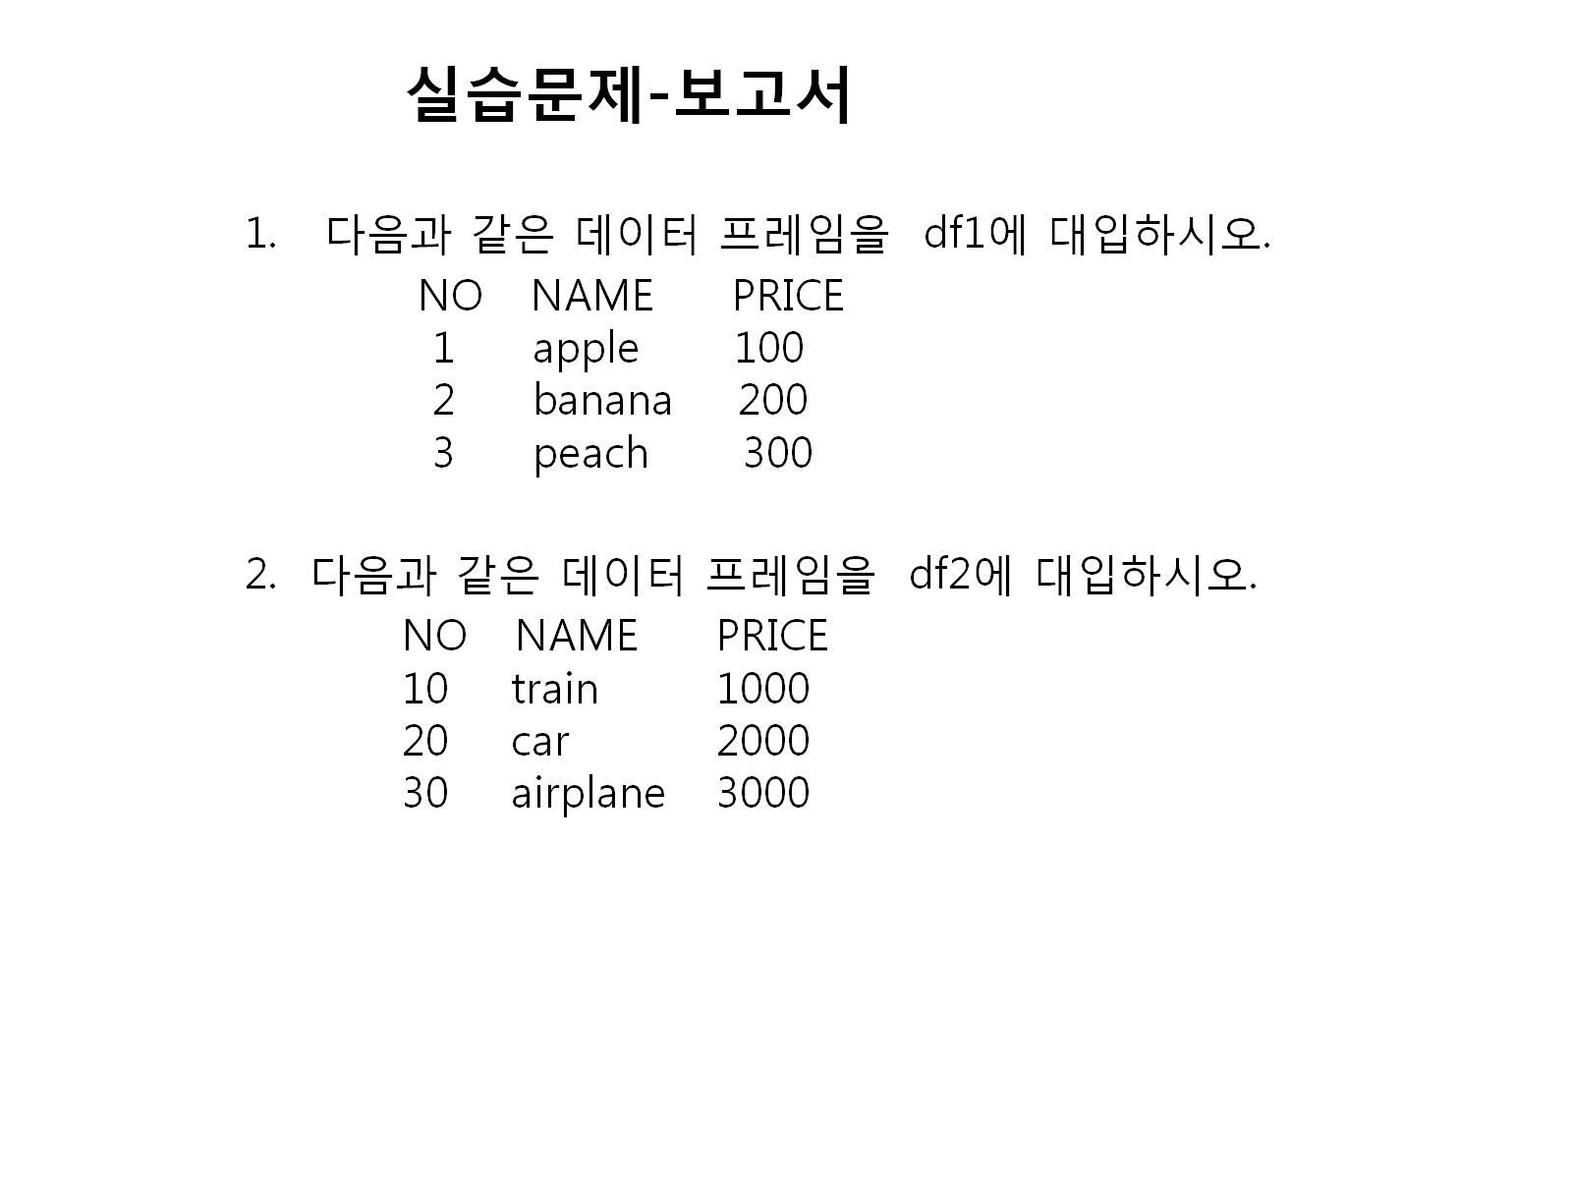
df1<-data.frame(no=c(1,2,3), name=c('apple','banana','peach'), price=c(100,200,300))
df1<-data.frame(NO=no, NAME=name,PRICE=price)
df1
df2<-data.frame(no=c(10,20,30), name=c('train','car','airplane'), price=c(1000,2000,3000))
df2<-data.frame(NO=no, NAME=name,PRICE=price)
df2

Slide 10
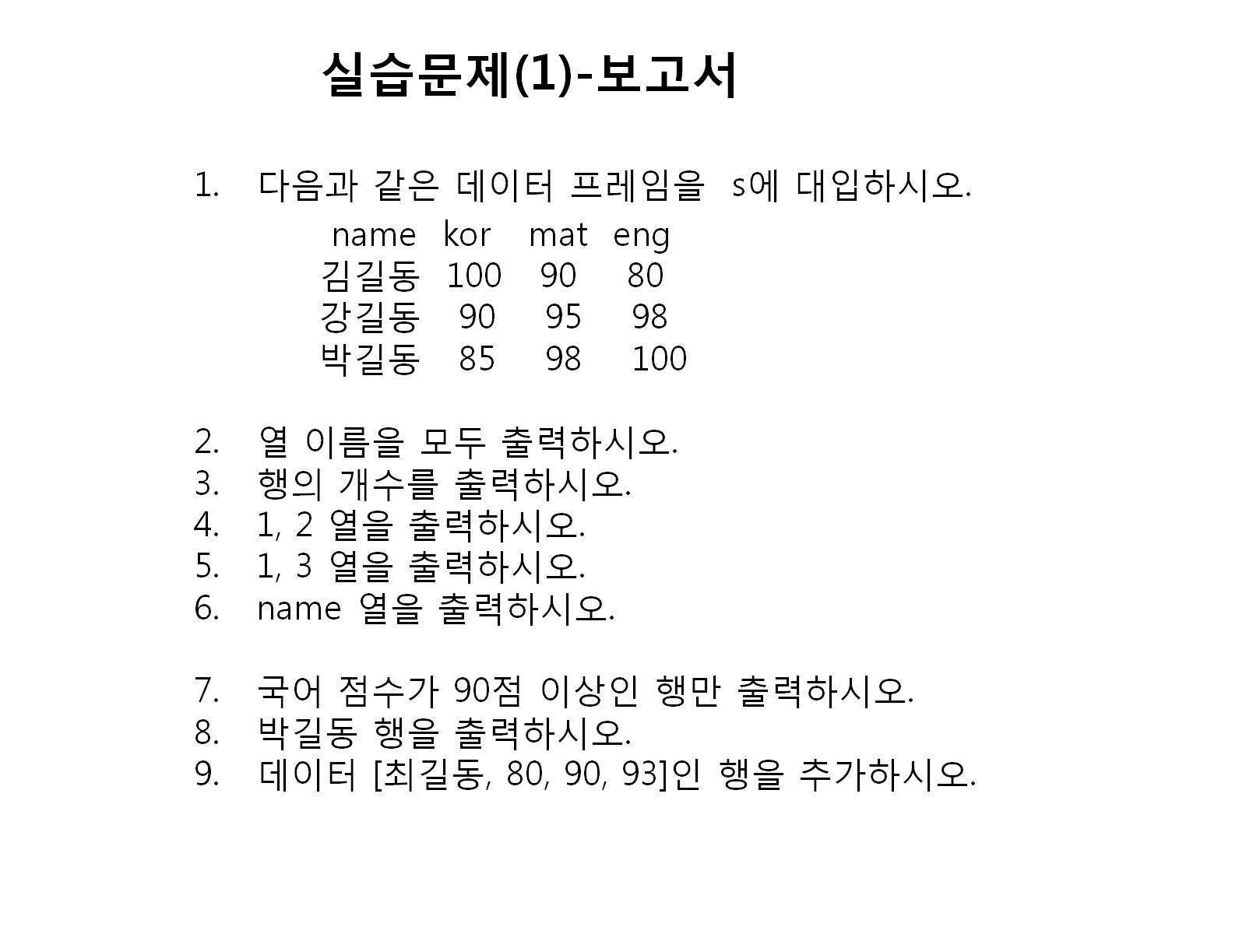
s<-data.frame(name=c('김길동','강길동','박길동'), kor=c(100,90,85), mat=c(90,95,98),eng=c(80,98,100))
s<-data.frame(name=name, kor=kor,mat=mat, eng=eng)
s
Notes:
s<-data.frame(name=c('김길동','강길동','박길동'), kor=c(100,90,85), mat=c(90,95,98),eng=c(80,98,100))
s<-data.frame(name=name, kor=kor,mat=mat, eng=eng)
s

Slide 11
실습문제(1)
s<-data.frame(name=c('김길동','강길동','박길동'), kor=c(100,90,85), mat=c(90,95,98),eng=c(80,98,100))
s<-data.frame(name=name, kor=kor,mat=mat, eng=eng)
s
names(s)
nrow(S)
s[,c(1,2)]
s[,c(1,3)]
s[,c(1)]
s[c(1,2),]
s[c(3),]
s<-rbind(s,data.frame(name="최길동",kor=80, mat=90, eng=93)

Slide 12
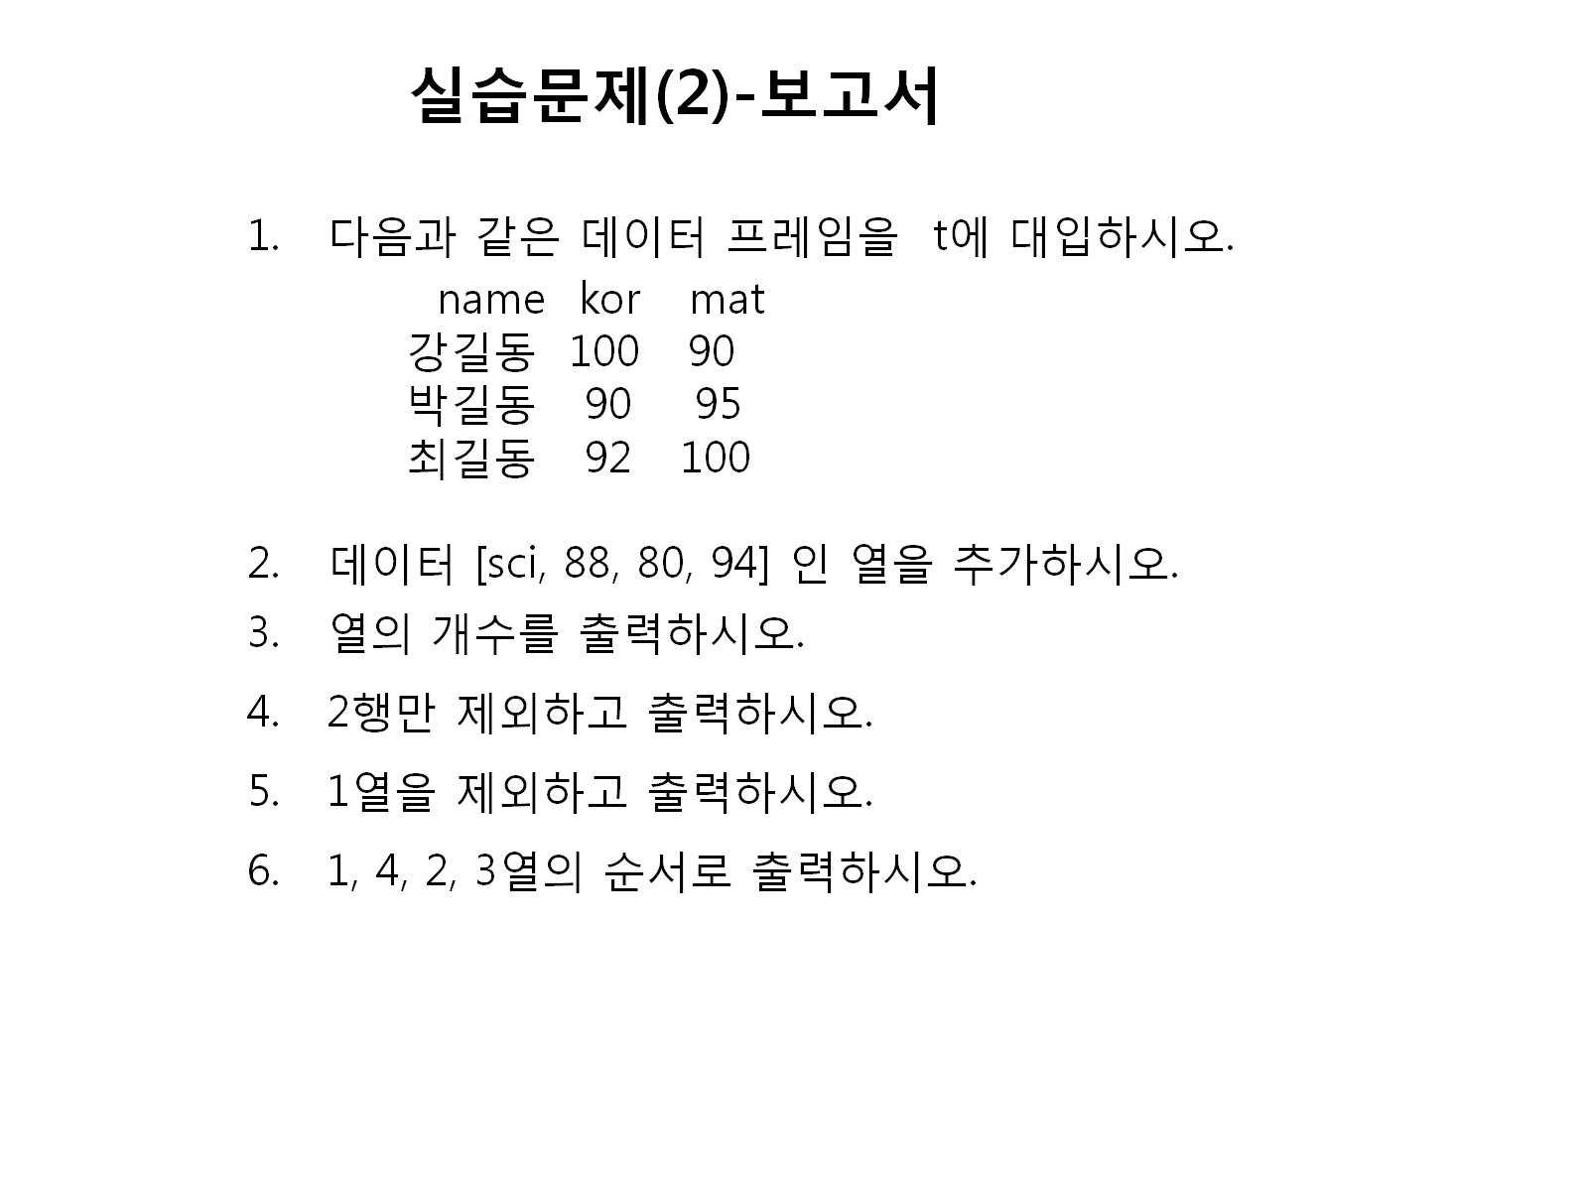

Slide 13
실습문제(2)
t<-data.frame(name=c('강길동','박길동','최길동'), kor=c(100,90,92), mat=c(90,95,100))
t<-data.frame(name=name, kor=kor,mat=mat)
t
t<-cbind(t,data.frame(sci=c(80,90,93)))
t
ncol(t)
t[c(-2),]
t[,c(-1)]
t[c(1,4,2,3)]

Slide 14
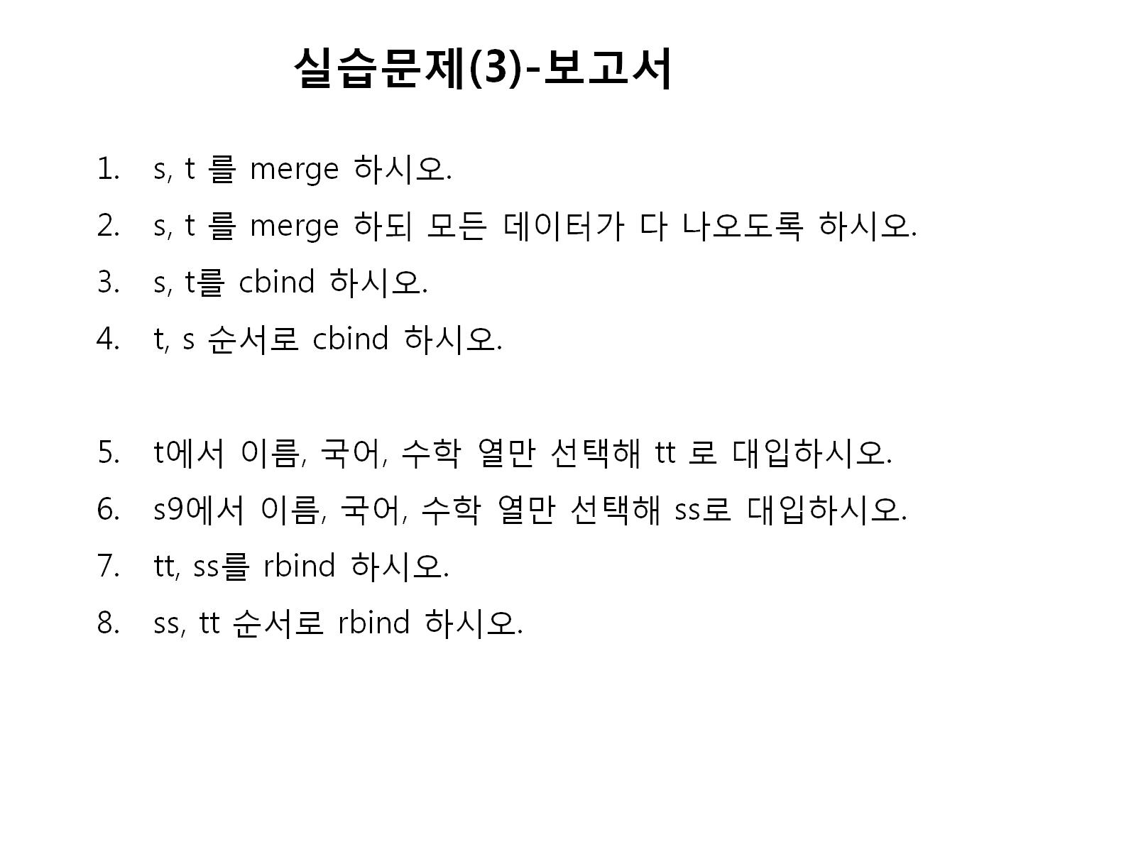

Slide 15
실습문제3
merge(s,t)
merge(s,t,all=T)
cbind(s,t)
cbind(t,s)
tt<-t[,c(1,2,3)]
tt
ss<-s[,c(1,2,3)]
ss
rbind(tt,ss)
rbind(ss,tt)

